Slide 1


House Predection
Team ML A
21 March 2025

Slide 2

List of Contents
Background & Problem Statement
Objectives & Scope
Data Collection
Data Preprocessing
Creating Baseline Mode
Feature Engineering
Modelling
Model Tuning
Conclusion

Slide 3

Background & Problem Statement
Background
The real estate market is dynamic and constantly changing, making house price prediction an important tool for buyers, sellers, investors, and real estate professionals. However, macroeconomic factors (interest rates, inflation, government policies), microeconomic factors (location, building size, facilities), and socio-demographic factors (population growth, urbanization trends) often drive property prices.
Problem Statement
Accurate prediction is needed to help stakeholders make the right decisions, whether it's buying a dream home or planning a profitable investment. In recent years, machine learning has emerged as a game changer in this field, offering unprecedented accuracy and insights compared to traditional statistical methods.
Reference: https://www.appliedaicourse.com/blog/house-price-prediction-using-machine-learning/

Slide 4
Objectives & Scope
Objective:
Create and compare machine learning model that predicts House Price. The goal is to identify / predict hous price based on important / strategic factors
Scope:
This project using data with house pricing information. The analysis will focus on applying prediction technique using Linear Regression, Random Forest and XGBoost

Slide 5
Data Collection
Data Source:
The dataset can be downloaded from here
Some Supporting Documents:
dataDefinision.md
data_description.txt
CategoricalEncodingnyaPakaiApa.xlsx

Slide 6
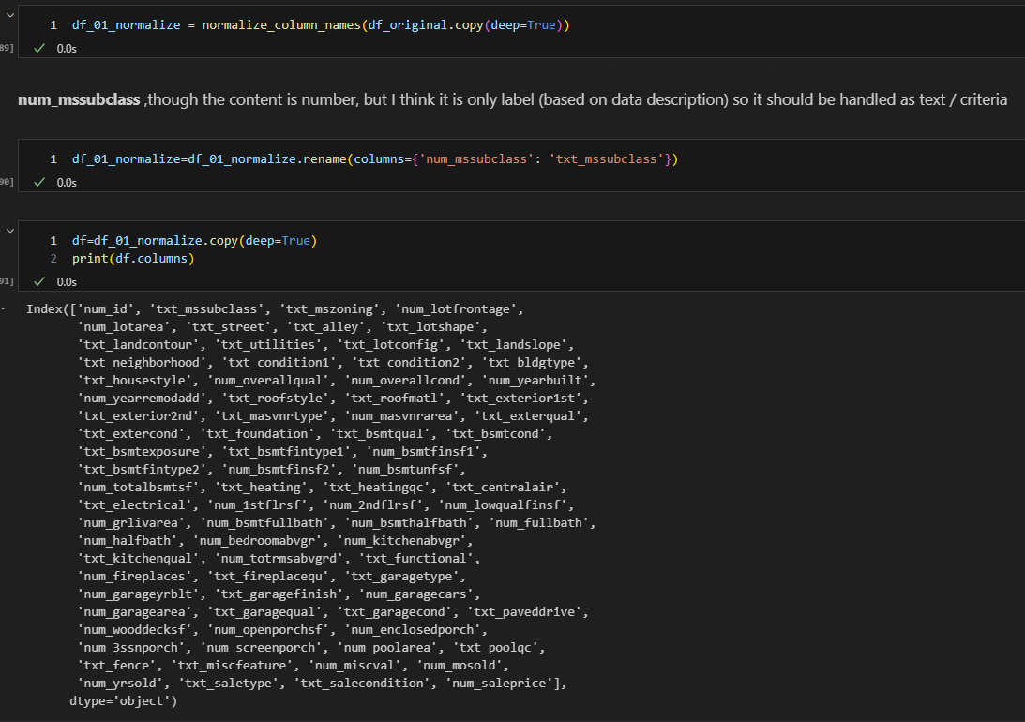
Data Preprocessing
Feature Name Normalization

Slide 7
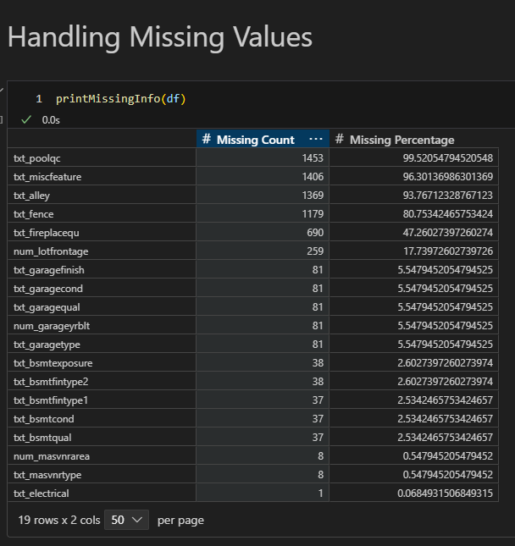
Data Preprocessing
Handling Missing Values

Slide 8
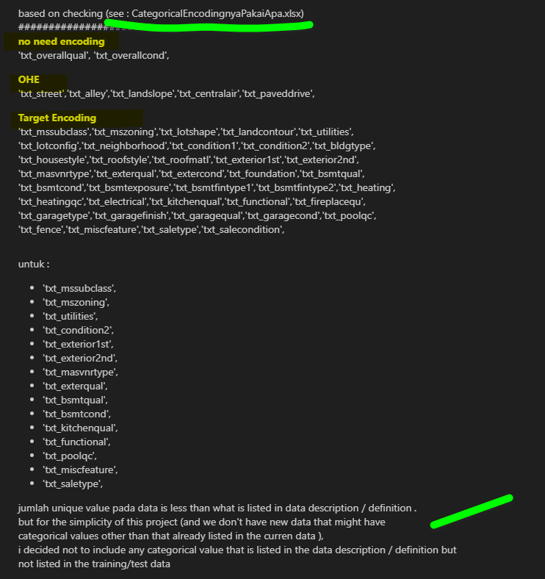
Data Preprocessing
Define Which One Will be One Hot Encoding and Which one will be Target Encoding

Slide 9
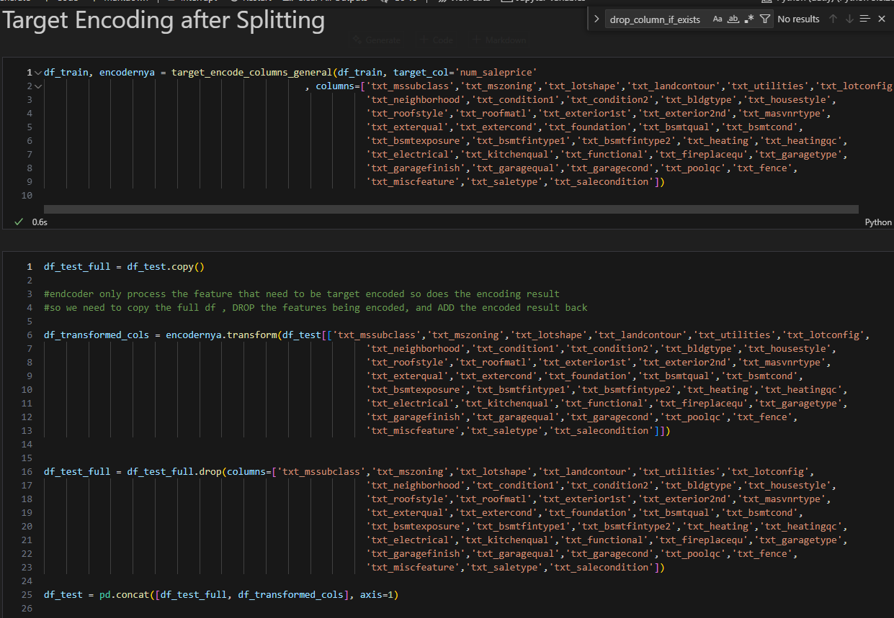
Data Preprocessing
Target Encoding After Splitting the data (to avoid data leakage from test data)

Slide 10
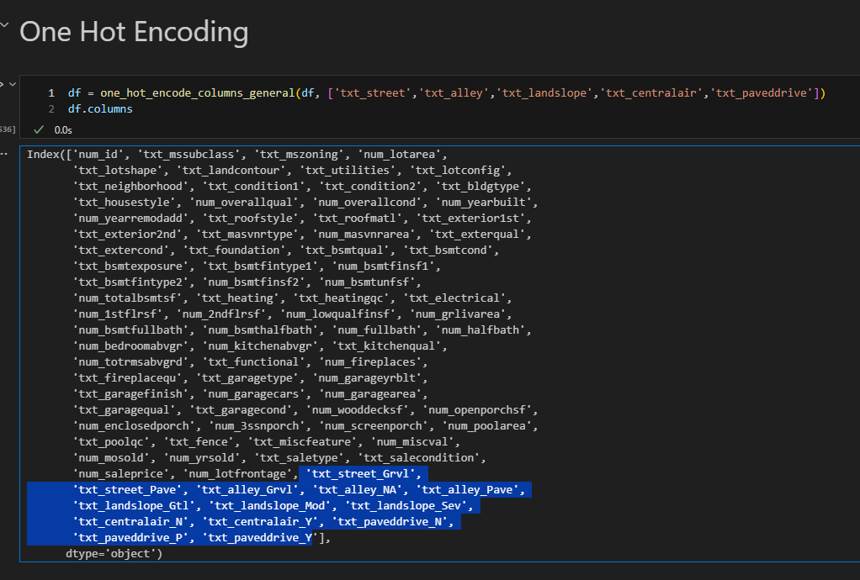
Data Preprocessing
One Hot Encoding

Slide 11
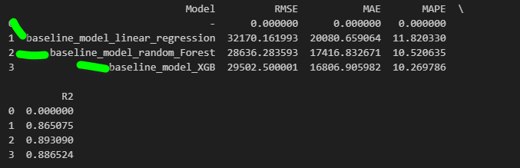
Creating Base Line Models
Correlation Matrix

Slide 12
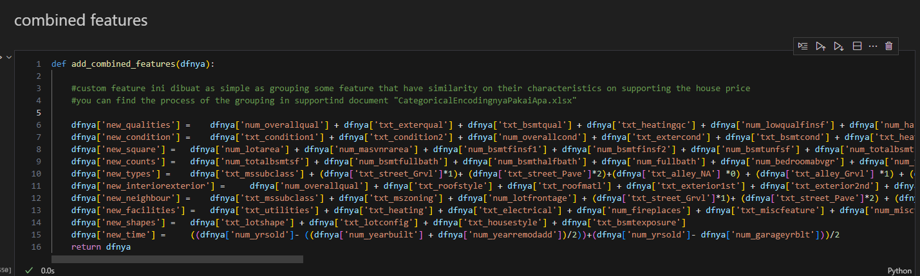
Feature Engineering
Create New Features

Slide 13
Feature Engineering
Other steps :
Drop features with weak correlation to target (<=0.05)
Drop features with high correlation between features (multi collinearity) (>0.8)
Drop features with high VIF Score (>5) ; canceled since it making model performance worse (by removing some important features)

Slide 14
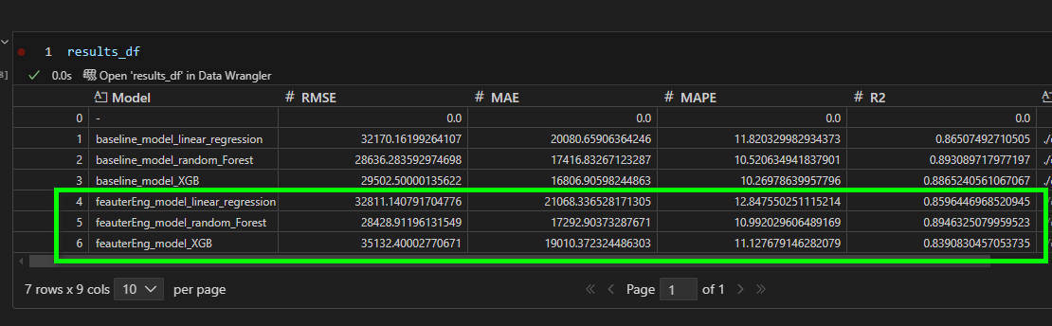
Modelling
Modelling after feature engineering prior to Tuning
Got performance drop for XGB
Got slight performance drop on Linear Regression
Got promising result with Random Forest

Slide 15
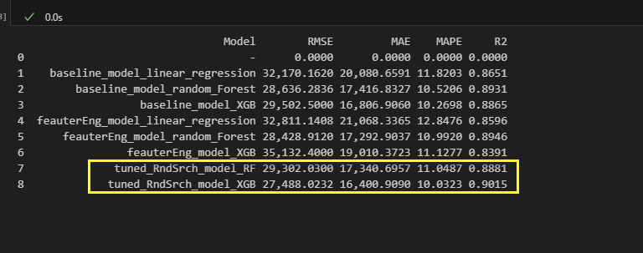
Model Tuning
Tune the Model with Random Search
XGB Model is the current Best Model
Random Forest without tuning #2 model

Slide 16
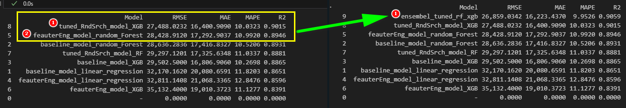
Model Stacking Models (Ensemble)
Stacking 2 Models : Tuned_XGB and Untuned Feature Enginered Random Forest Model

Slide 17
Conclusion
Combining the tuned XGB and the feature-engineered Random Forest resulted in the model with the lowest error in this experiment; although the improvement is not very significant, it at least managed to smooth out the previous best result (the tuned XGB model).

